Slide 1

Moving Object Tracking Distance and Velocity Determination based on Background Subtraction Algorithm
Guides
Dr.Y.Raghavender Rao
&
Mr T. Mohan Das
By
N.Ravalika
P.Priyanka
Md. Riyazuddin

Slide 2
CONTENTS
Introduction
Aim
Literature survey
Background subtraction algorithm
Block diagram of back ground subtraction algorithm
Frame difference
Velocity
Block diagram of propsed system
Simlulation results
Conclusion and future scope
References

Slide 3
INTRODUCTION
Object tracking in a complex environment has long been an interesting and challenging problem.
This project deals with the single object tracking, background subtraction, and object detection.
Detection of moving objects is a very important task in mobile robotics and surveillance applications.
Tracking can be defined as the problem of estimating the trajectory of an object as the object moves around a scene. It is necessary to know where the object is in the image at each instant in time. If the objects are continuous observable and their sizes or motion does not vary over time, then tracking is not a hard problem

Slide 4
AIM
The motivation behind this project is to develop software for tracking, the major application in security, surveillance and vision analysis. The developed software must be capable of tracking any single object moving in the frame and to simulate on software. This system might be useful for extending in real-time surveillance or object classification.
Goal of this project is to develop an algorithm for tracking an object and determining the frame subtraction and object detection. Algorithms can be extended for real time applications.

Slide 5
LITERATURE SURVEY
There are three ways for detecting motion in image sequences
1. Temporal difference
2. Optical flow
3. Background subtraction
Lipton et al ,proposed frame difference that use of the pixel-wise differences between two frame images to extract the moving regions.
Liu et al ,proposed background subtraction to detect moving regions in an image by taking the difference between current and reference background image in a pixel-by-pixel.

Slide 6

BACKGROUND SUBTRACTION ALGORITHM
Background subtraction is a computational vision process of extracting foreground objects in a particular scene.
A foreground object can be described as an object of attention which helps in reducing the amount of data to be processed as well as provide important information to the task under consideration.
Often, the foreground object can be thought of as a coherently moving object in a scene

Slide 7
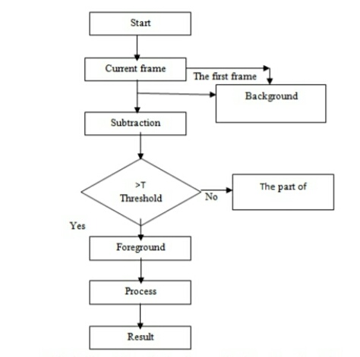
BLOCK DIAG OF BACKGROUD SUBTRACTION ALGORITHM

Slide 8
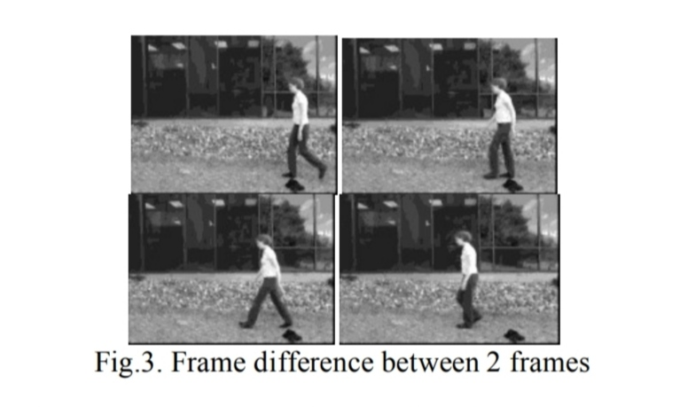
FRAME DIFFERENCE
Frame difference calculates the difference between two frames at every pixel position and store the absolute difference.
It is used to visualize the moving objects in a sequence of frames.
Let us consider an example, if we take a sequence of frames, the present frame and the next frame are taken into consideration at every calculation and the frames are shifted (after calculation the next frame becomes present frame and the frame that comes in sequence becomes next frame).

Slide 9
VELOCITY
The velocity of moving object is calculated by the distance it travelled with respect to the time. Euclidean distance formula is used to calculate the distance between the sequences of frames.
By using the values of distance with respect to frame rate, the velocity of the object is defined. The defined velocity is of 2-dimension (since camera is static).
Velocity of moving object is determined using the distance travelled by the centroid to the frame rate of the video.
The velocity of moving object in the sequence frames is defined in pixels / second.

Slide 10
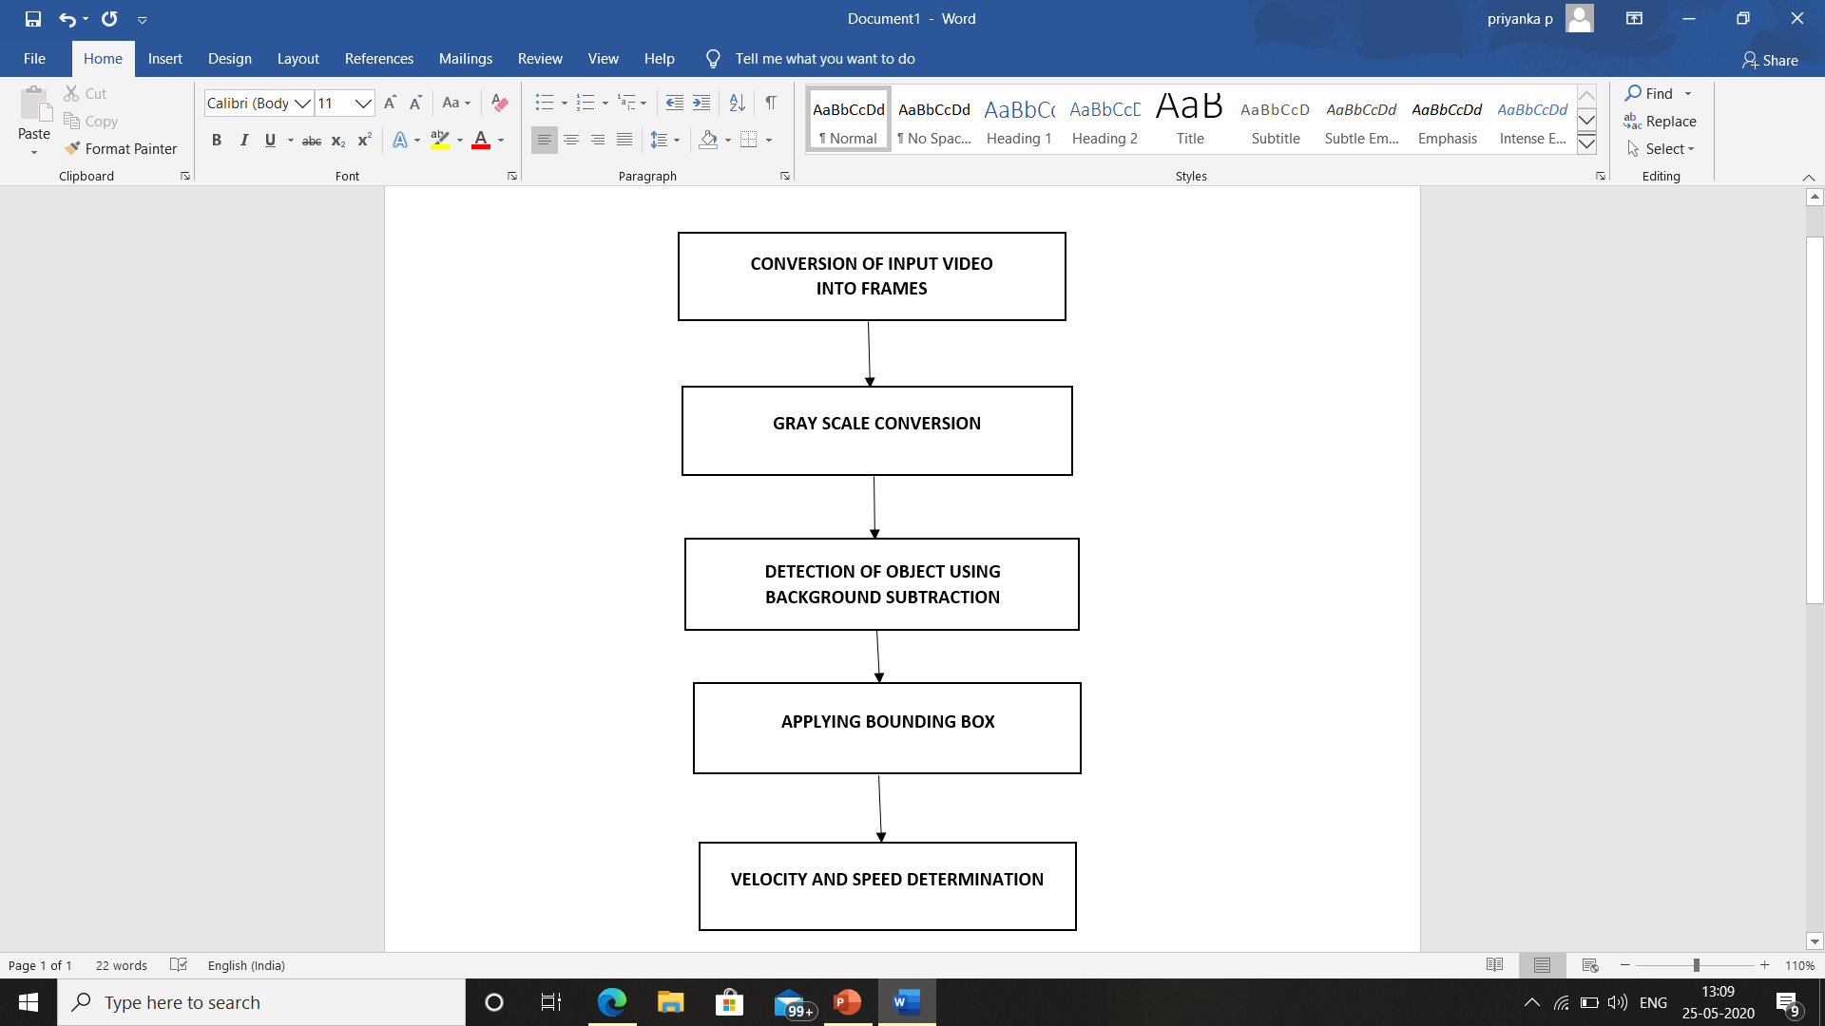
BLOCK DIAG OF PROPOSED METHOD

Slide 11
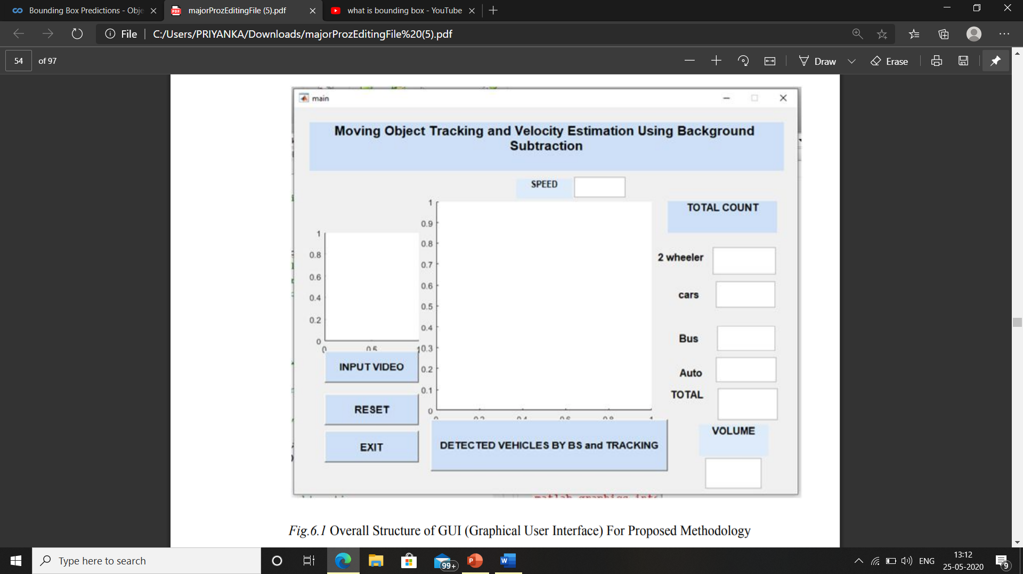
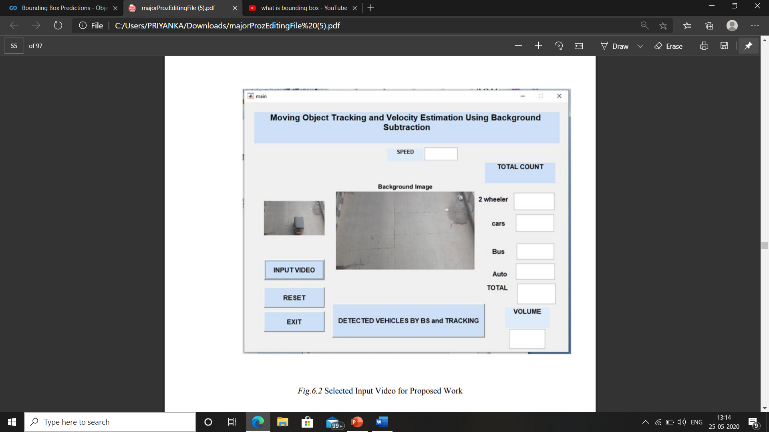
SIMULATION RESULTS

Slide 12
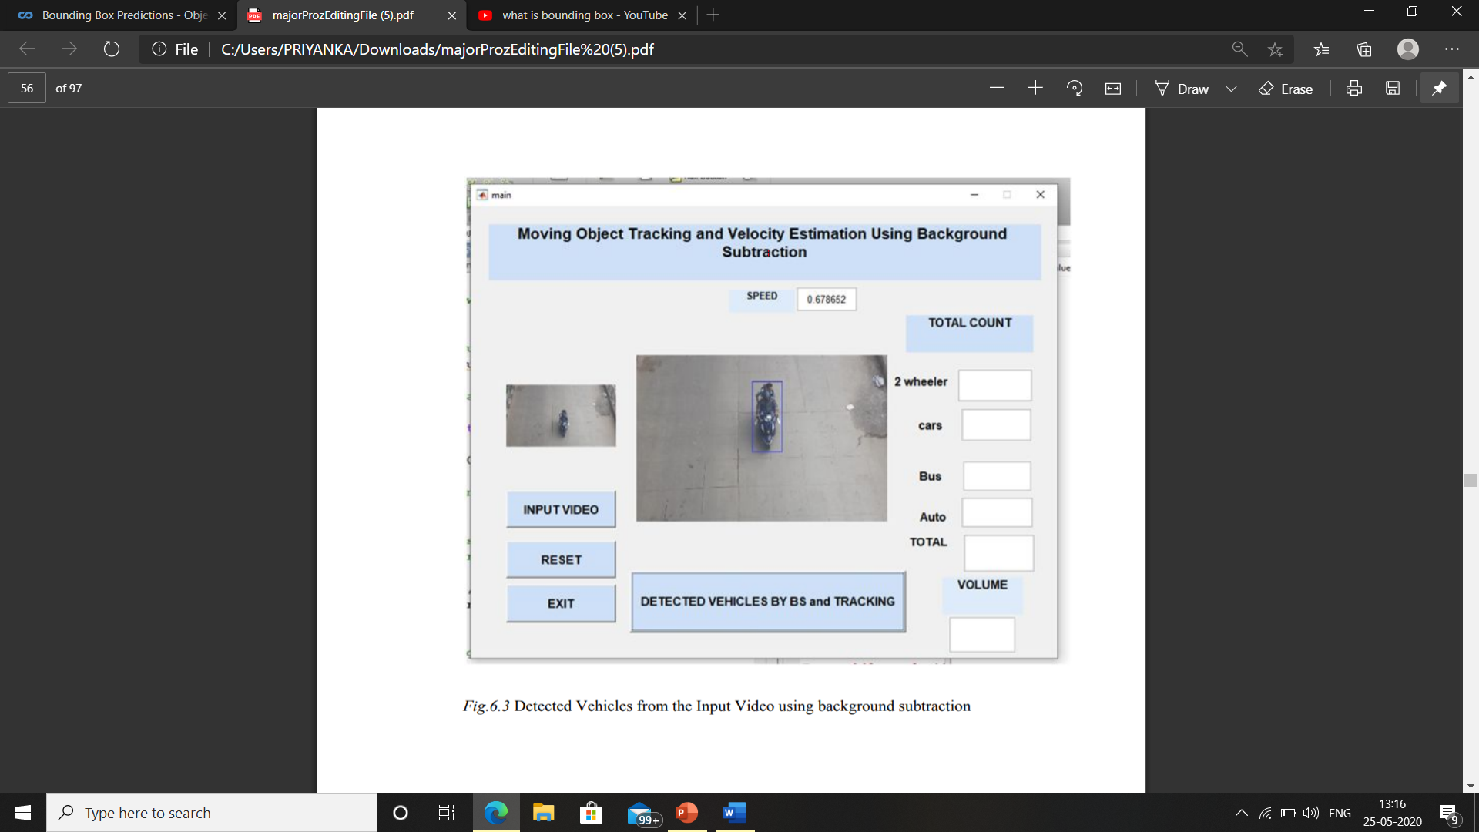
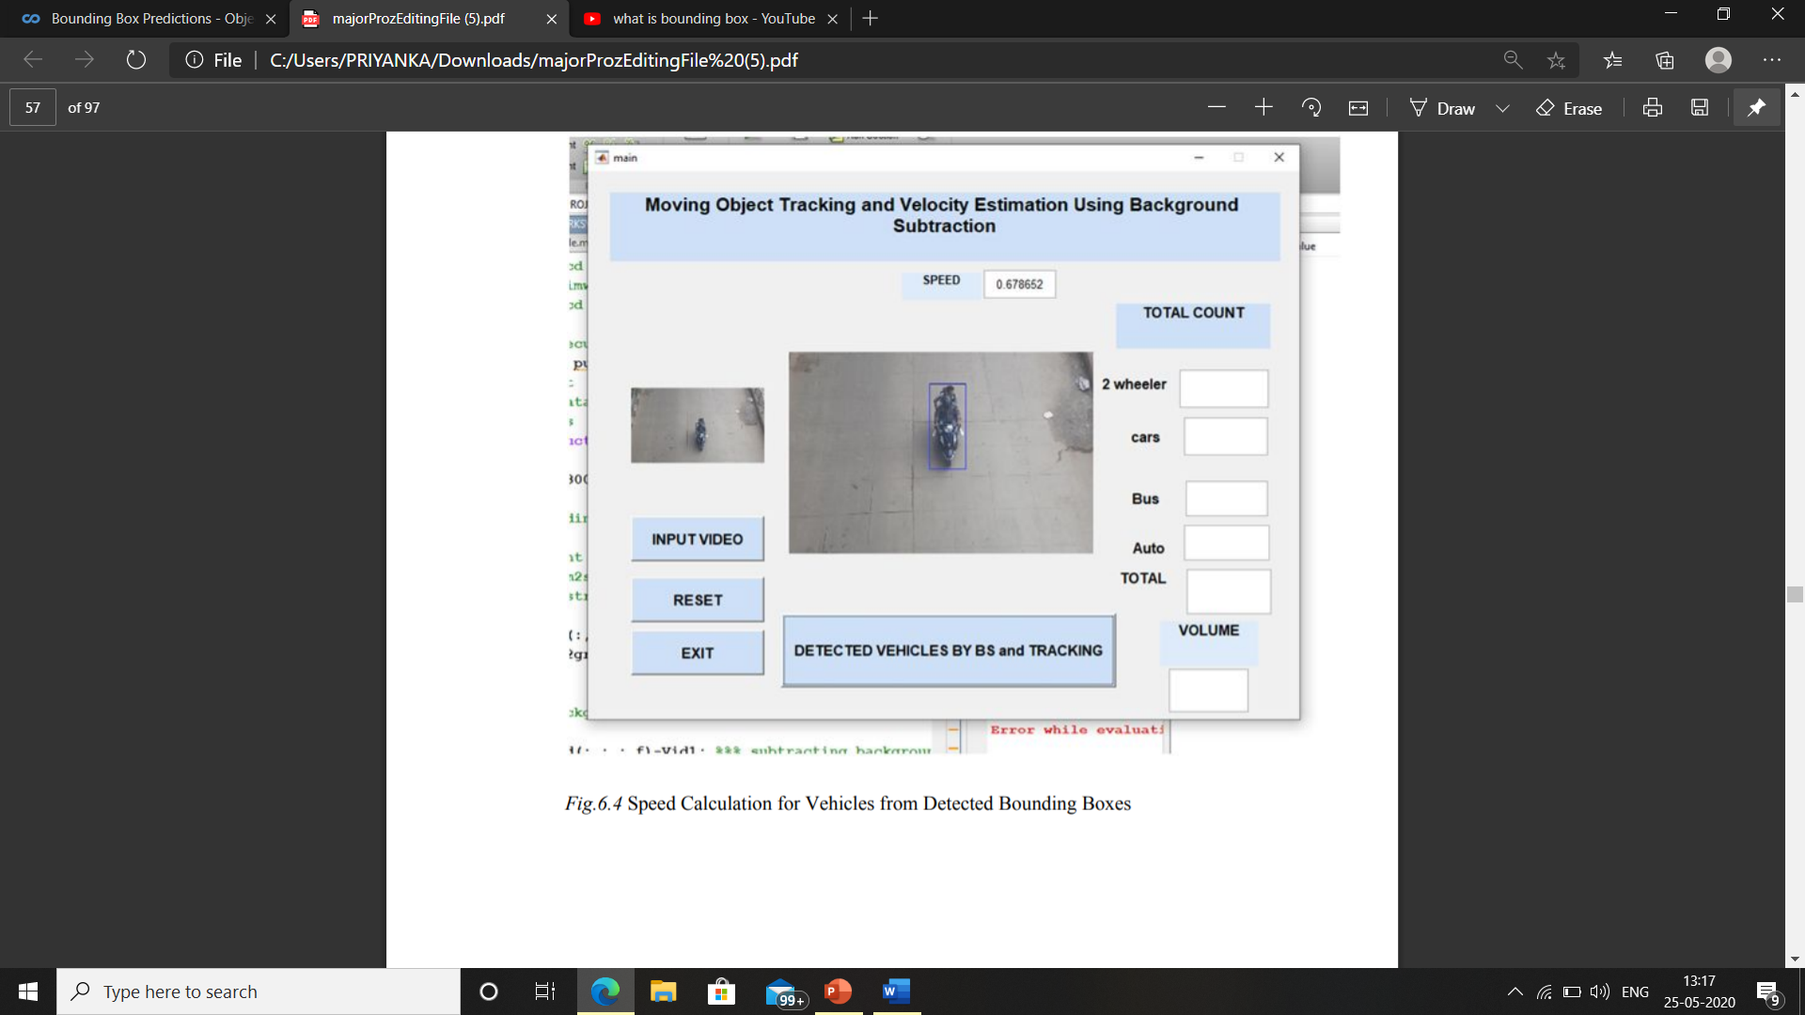

Slide 13
CONCLUSION
Tracking of moving object is a major application in security, surveillance and vision analysis. In this, a video is recorded using digital camera. The recorded video frames are converted into individual frames.
Noise is removed for the imported images using median filter and morphological filter. The filtered images are used as input for the frame difference for the separation of foreground and background objects. The background subtraction using dynamic threshold and morphological process.
In dynamic threshold based object detection, morphological process and filtering also used effectively for unwanted pixel removal from the background. These methods are used effectively for object detection and most of previous methods depend on the assumption that the background is static over short time periods.

Slide 14
FUTURE WORKS
The algorithms used in this project can also be extended for the use of realtime applications and object classifications.
Future work as will extensions of the algorithm to include a kinematic the smooth movement of objects, CC analysis, Object boundary box, distance and velocity determination

Slide 15
REFERENCES
https://pdfs.semanticscholar.org/b8d1/b143f18a450b973c8b6ca9308c8e62e3bf66.pdf
https://www.researchgate.net/publication/262840375_Moving_Object_Detection_Using_Background_Subtraction

